Slide 1
Is Southern California the land of gluten(y) or the land of the gluten-free?
Espresso Patronum Presents...
Connie hu
Molly Perlich
Riley Harper
Scott McEachern

Slide 2
Agenda
Project Summary
Results
Data Collection
Data Analysis
Conclusion

Slide 3
Project Summary
We wanted to examine the prevalence of gluten-free friendly restaurants in relation to the income of a given area. Our hypothesis was that there would be more gluten-free friendly restaurants in higher income areas of Southern California (using zip codes to measure area). We used API data from Yelp and the US Census Bureau to help us answer the following questions.
Is eating gluten-free more expensive?
Is there a relationship between overall income for Southern California vs. the amount of access?
Is there a relationship between being rich and the amount of access to gluten-free options?
Notes:
Add specifics – location gf friendly

Slide 4
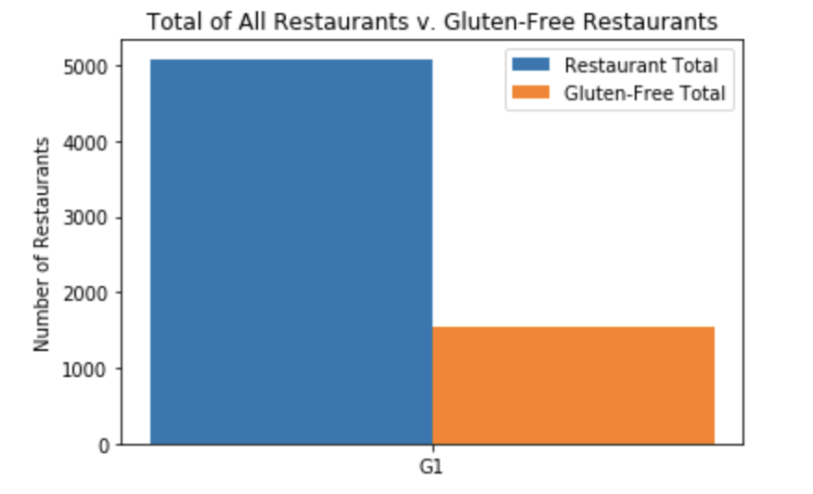
Only 30% # of TOTAL RESTAURANTS in Southern California are GLUTEN-FREE friendly
Figure 1

Slide 5
Is eating gluten-free more expensive?
Question 1
Yes...

Slide 6
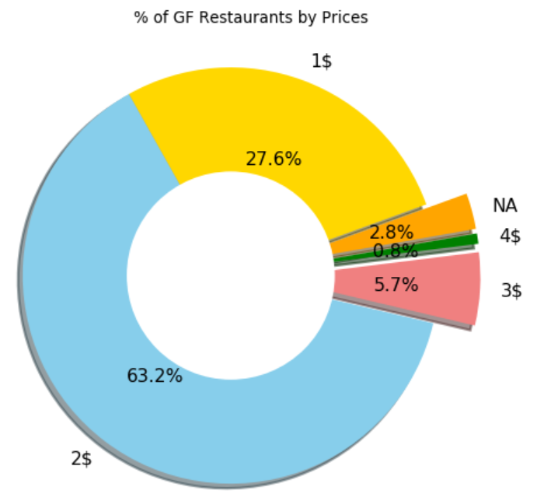
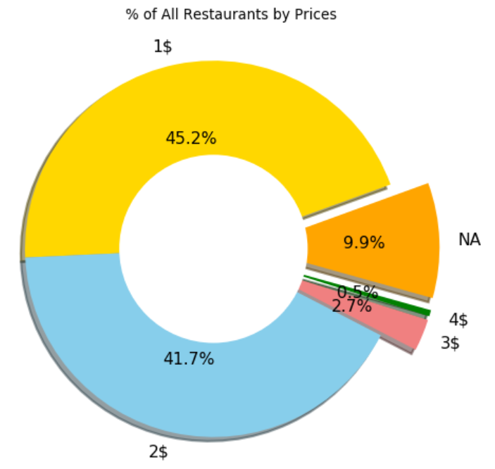
27.6% of GF are $ 45.2% of All Rest. are $ 63% of all GF are $$ 42% of All Rest. are $$
Figure 2

Slide 7
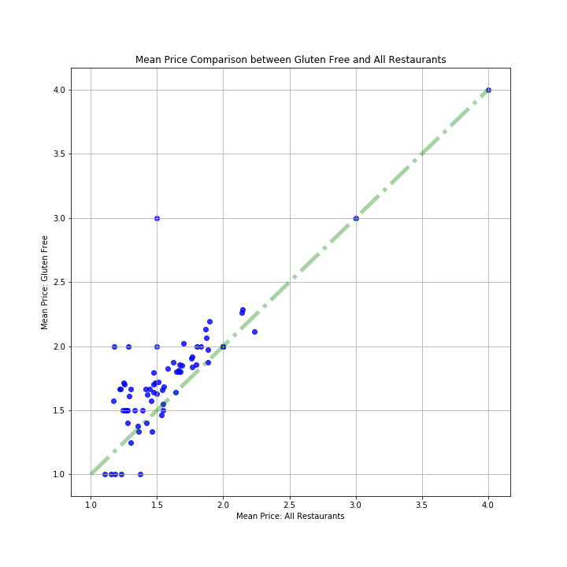
Comparing the overall cost of gluten-free with the overall cost of all restaurants
Figure 3
Notes:
Scott, put your graph here

Slide 8
Is there a relationship between overall income for Southern California and the amount of access to gluten-free friendly restaurants?
Question 2
No...

Slide 9
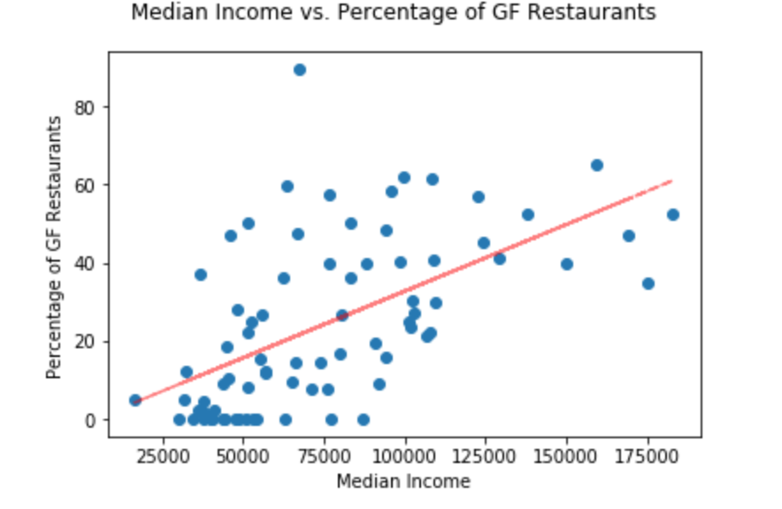
Is there a relationship between overall income And the amount of access To gluten-free friendly restaurants?
Figure 4
No, Analyzing the linear regression line there is no discernable relationship between median income and number of gluten-free friendly restaurants.
Notes:
Is there a relationship between overall income And the amount of access To gluten-free friendly restaurants? No, Analyzing the linear regression line there is no discernable relationship between median income and number of gluten-free friendly restaurants.

Slide 10
Is there a relationship between being rich and the amount of access to gluten-free?
Question 3
No...

Slide 11
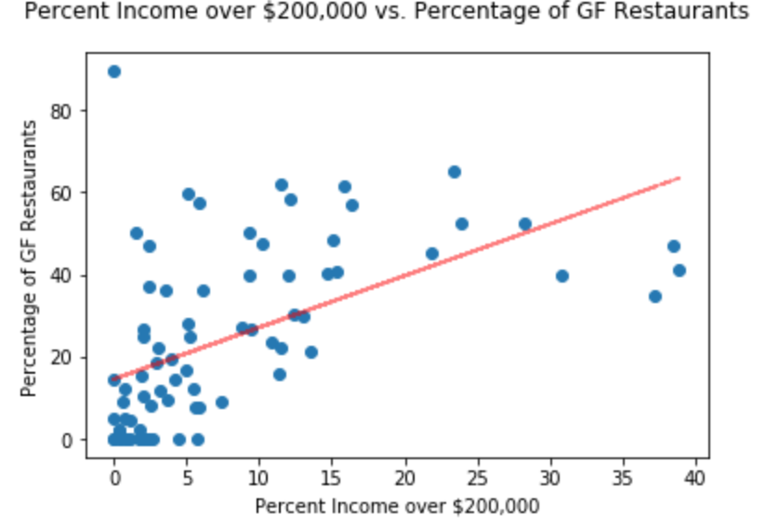
Is there a relationship between overall income And the amount of access To gluten-free friendly restaurants? No, Analyzing the linear regression line there is no discernable relationship between income greater than $200,000 and number of gluten-free friendly restaurants.
Figure 5

Slide 12


Data Collection

Slide 13
Data Sources
Yelp API
Yelp API contains ability to search for businesses and filter on location and categories
Collected datasets based:
Gluten Free & Restaurant
Restaurant
US Census Bureau API
Collected 2016 supplemental data to examine income levels for zip codes

Slide 14
Data Collection Workflow
1 DataCollection_Yelp.ipynb
Random Zip Codes
2 DataCollection_Census.ipynb
Collect Census Data
Loop through Zip Codes
API Call
Query: "Gluten Free" & "Restaurant"
Calculate High Income
API Call
incomebyzip.csv
Query: "Restaurant"
API Call
Merge into single DataFrame
Write to disk
YelpDataZip_{Zipecode}.csv
3 DataCollection_Merge.ipynb
Merge Census with Yelp
Merge all Zip Code Files
YelpData.csv
Final_merged_data.csv
Summarize each Zip Code
SummarizedYelpData.csv

Slide 15
Walk Through: Data Collection
Yelp Data
https://github.com/connie-hu/DataViz_Project/blob/master/Solution/1_DataCollection_Yelp.ipynb
Census
https://github.com/connie-hu/DataViz_Project/blob/master/Solution/2_DataCollection_Census.ipynb
Merge
https://github.com/connie-hu/DataViz_Project/blob/master/Solution/2_DataCollection_Census.ipynb

Slide 16
Data Analysis
Regression Notebook
Notes:
Looking at regression (1 minute)

Slide 17
Conclusions
Our Findings
Considerations & Limitations
Yelp Query Limitation
Other Data Sources
Google Trends
Celiac Disease Data
Very Difficult Data to Get
Geospatial Analysis with Wealth and Proximity to GF outside of zipcodes
Lessons learned
The Big Question – be specific
Data Exploration Process - sets expectations
GitHub/Collaboration
Notes:
The big question – learning to ask the right questions and what are we trying to solve – narrowing down the big question to a specific question. Due to data driven perhaps?
Data exploration process – we like to think big! But only when we are looking at what data is available we come back down to Earth a little to do a reality check.

Slide 18
Questions?

Slide 19
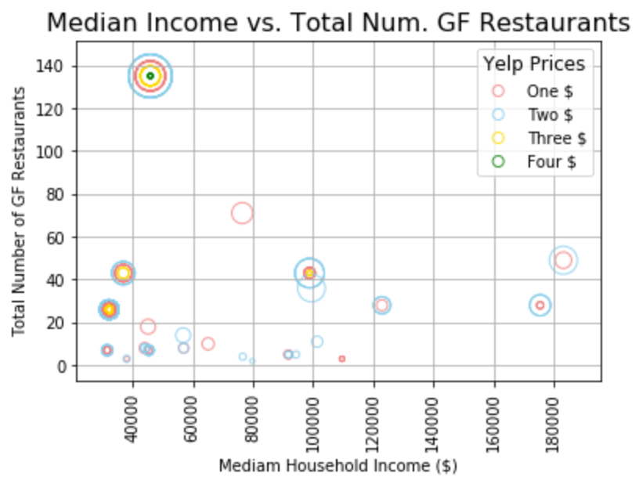
At each income level we can see that there are more $$ gluten-free friendly restaurants than any other price level.​
Notes:
At each income level we can see that there are more $$ restaurants than any other price level.

Slide 20
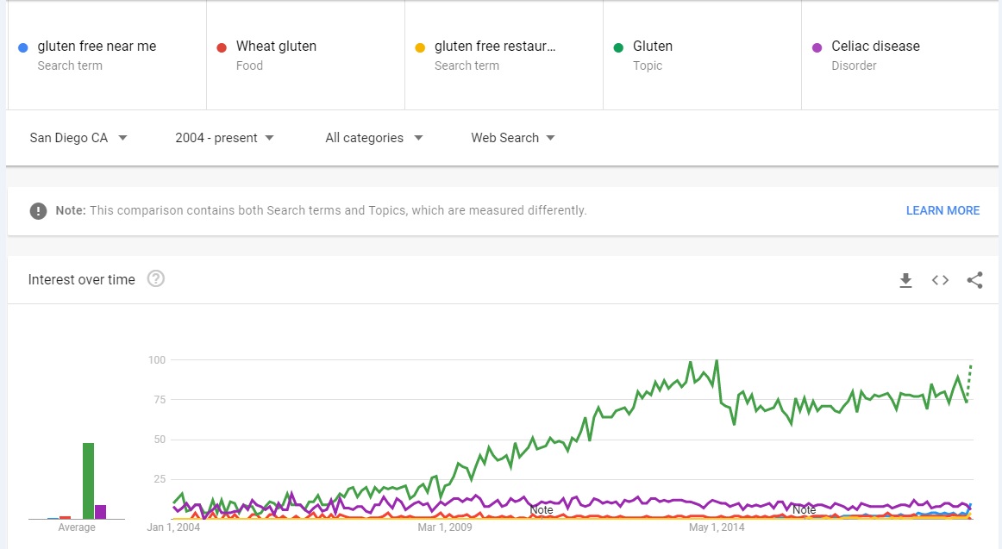
Google Trends

Slide 21
Intro and Results: (Molly): 4
Data Collection: 4
Analysis: 2
Conclusion: 2

